Slide 1

Real Estate F&D ETE III Year (V semester) Group : 22 of Bachelor of Technology in Computer Science & Engineering By: Abhijeet Dass(2010991223) -16 Anurag Handa(2010991233)-17 Arshdeep Singh(2010991237)-18 Submitted to: Mr.Anil Dhawan

Slide 2
Description of the project This is a project for resolving the issue of searching a property which is required by the user with the help of various filters . The data shown in the project is being fetched by an API.

Slide 3
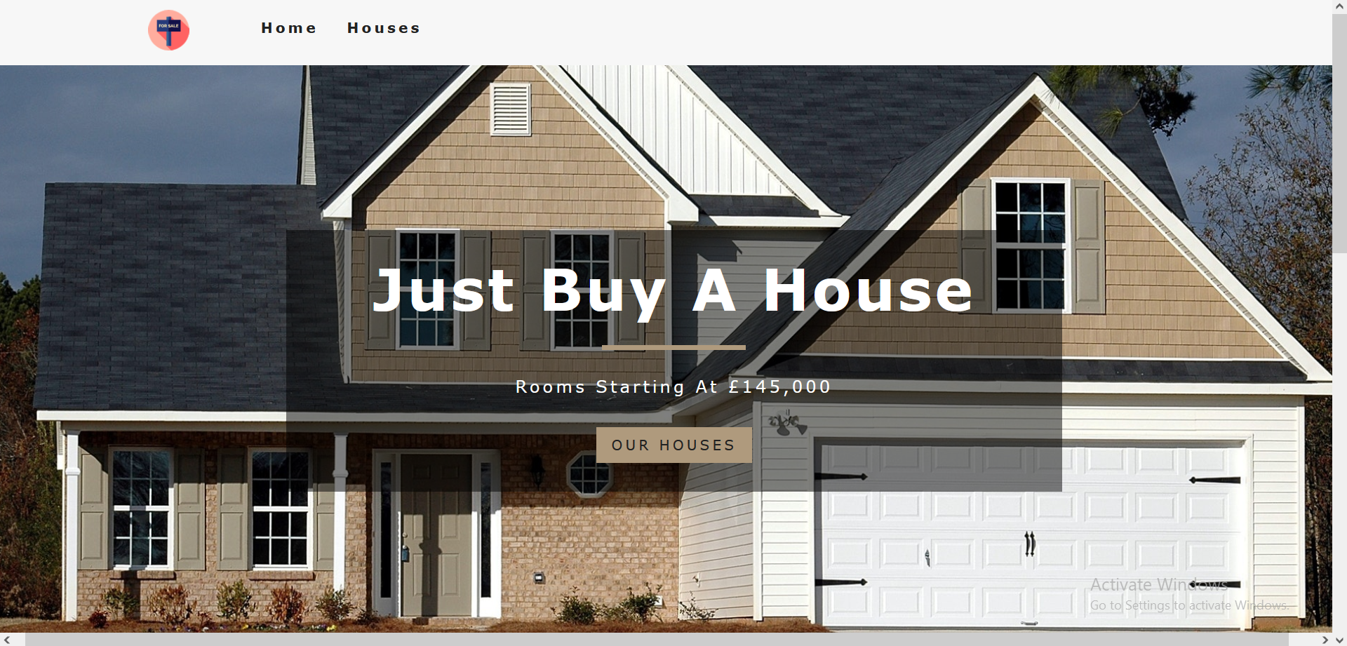
Overview Of Project:- 1. Home Page

Slide 4
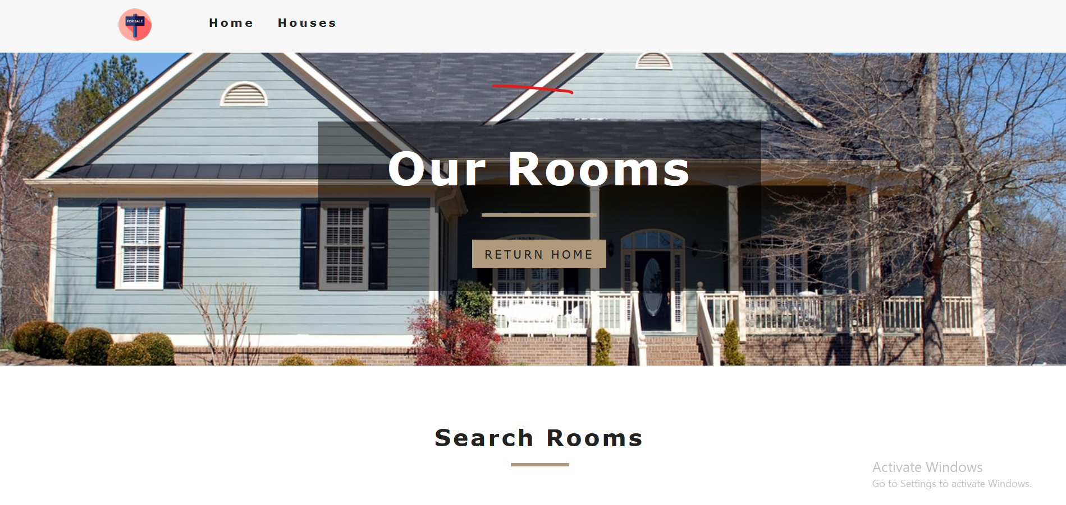
ROOMS PAGE:-

Slide 5
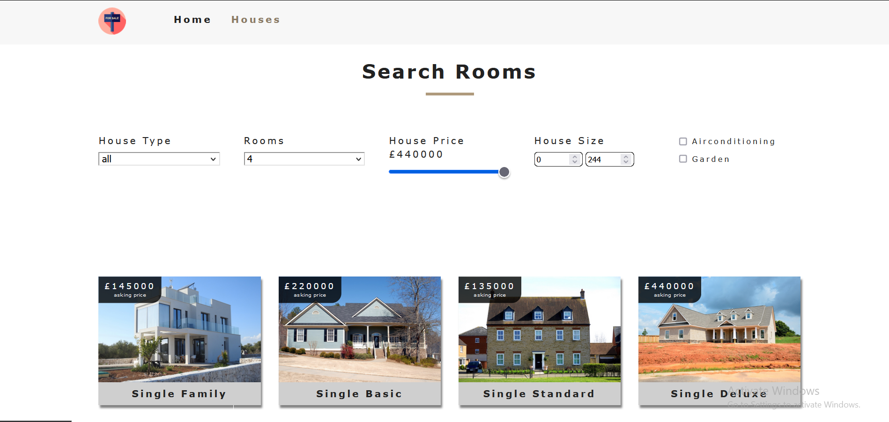

Slide 6
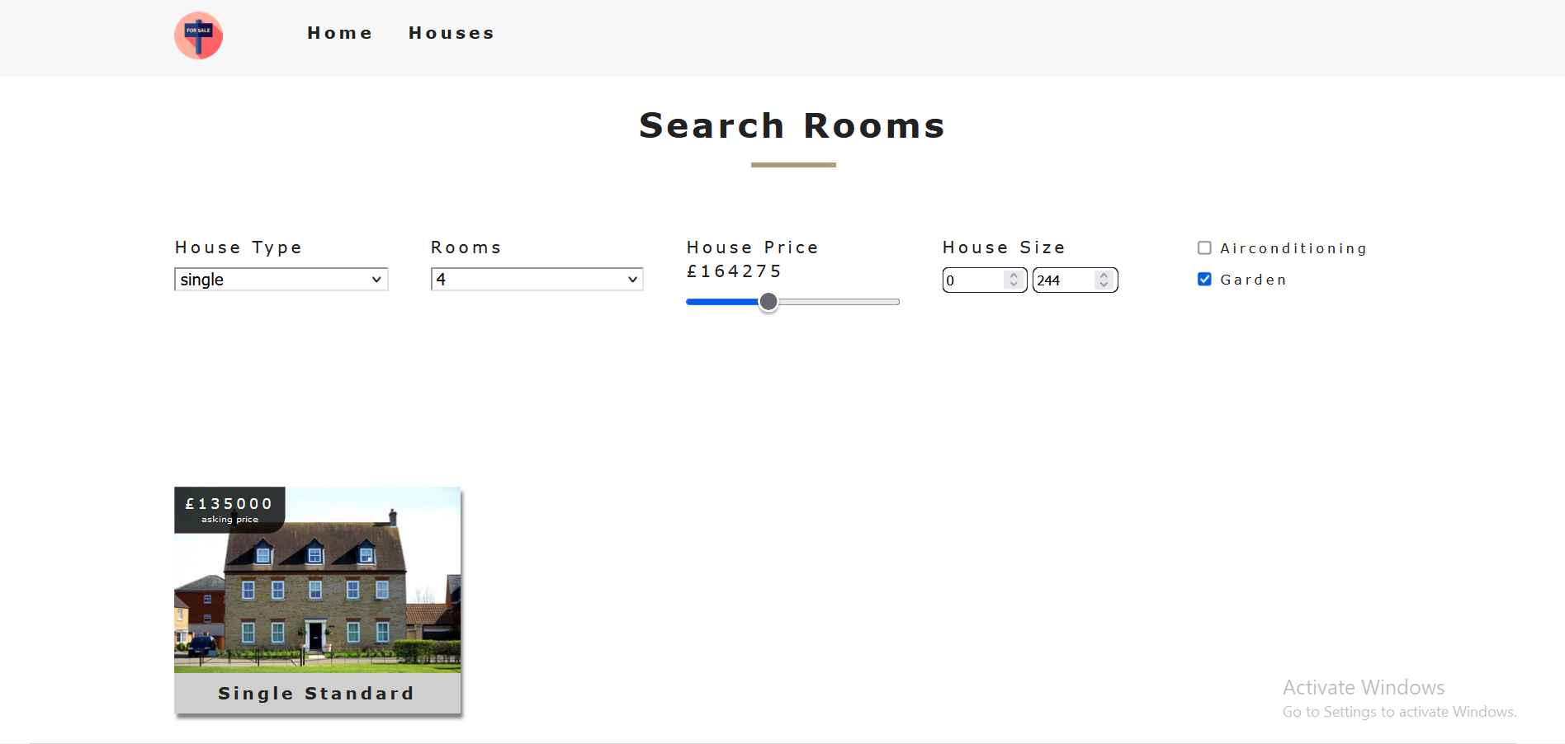
Changes after applying Filters

Slide 7
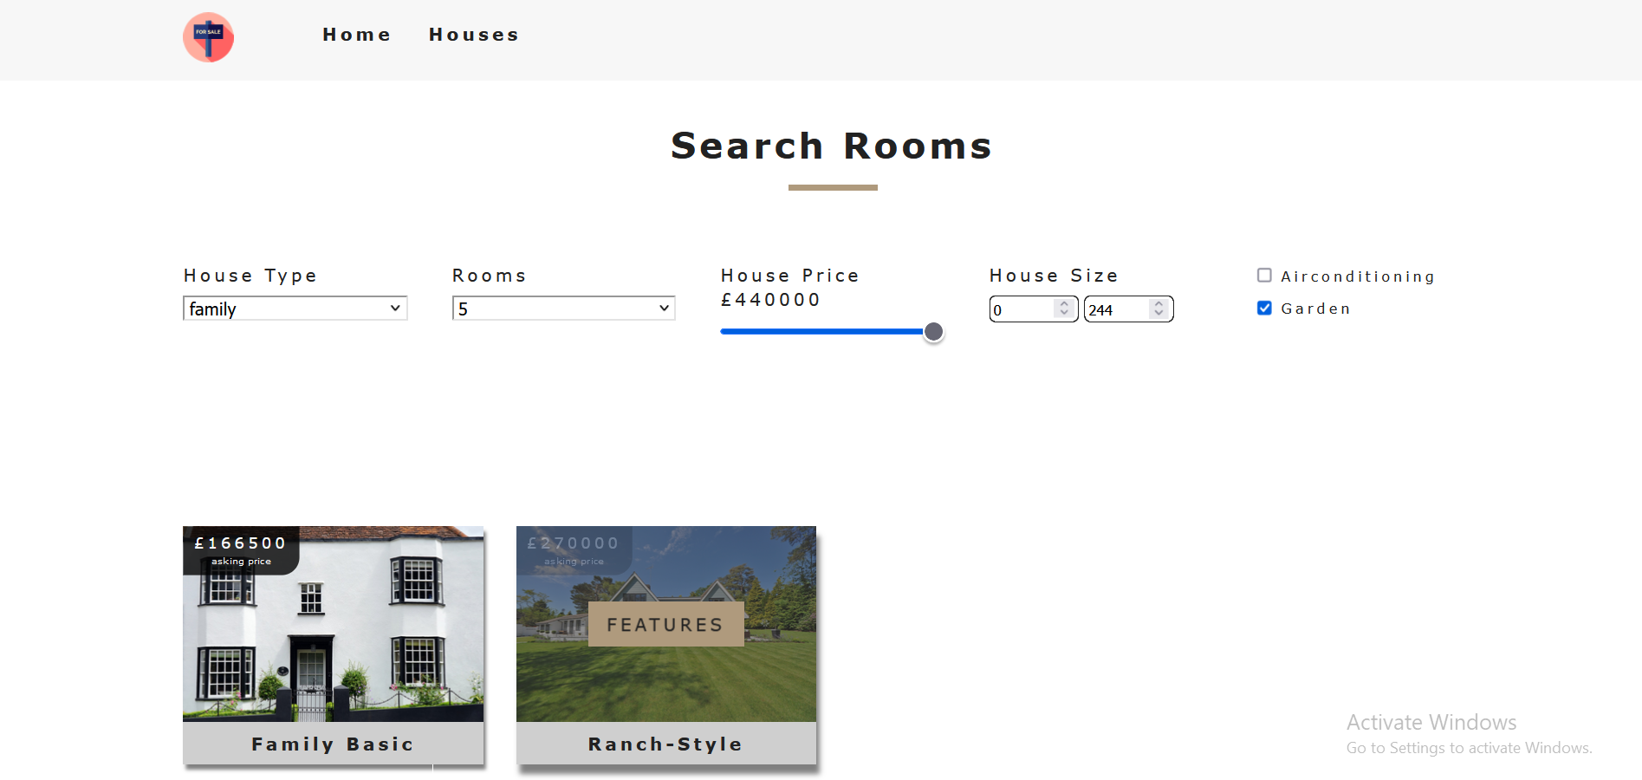

Slide 8
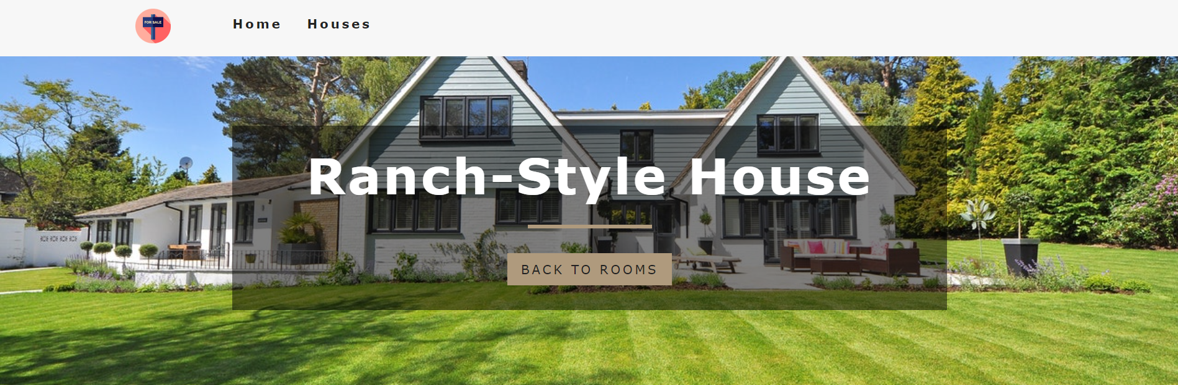
After clicking on a particular house

Slide 9
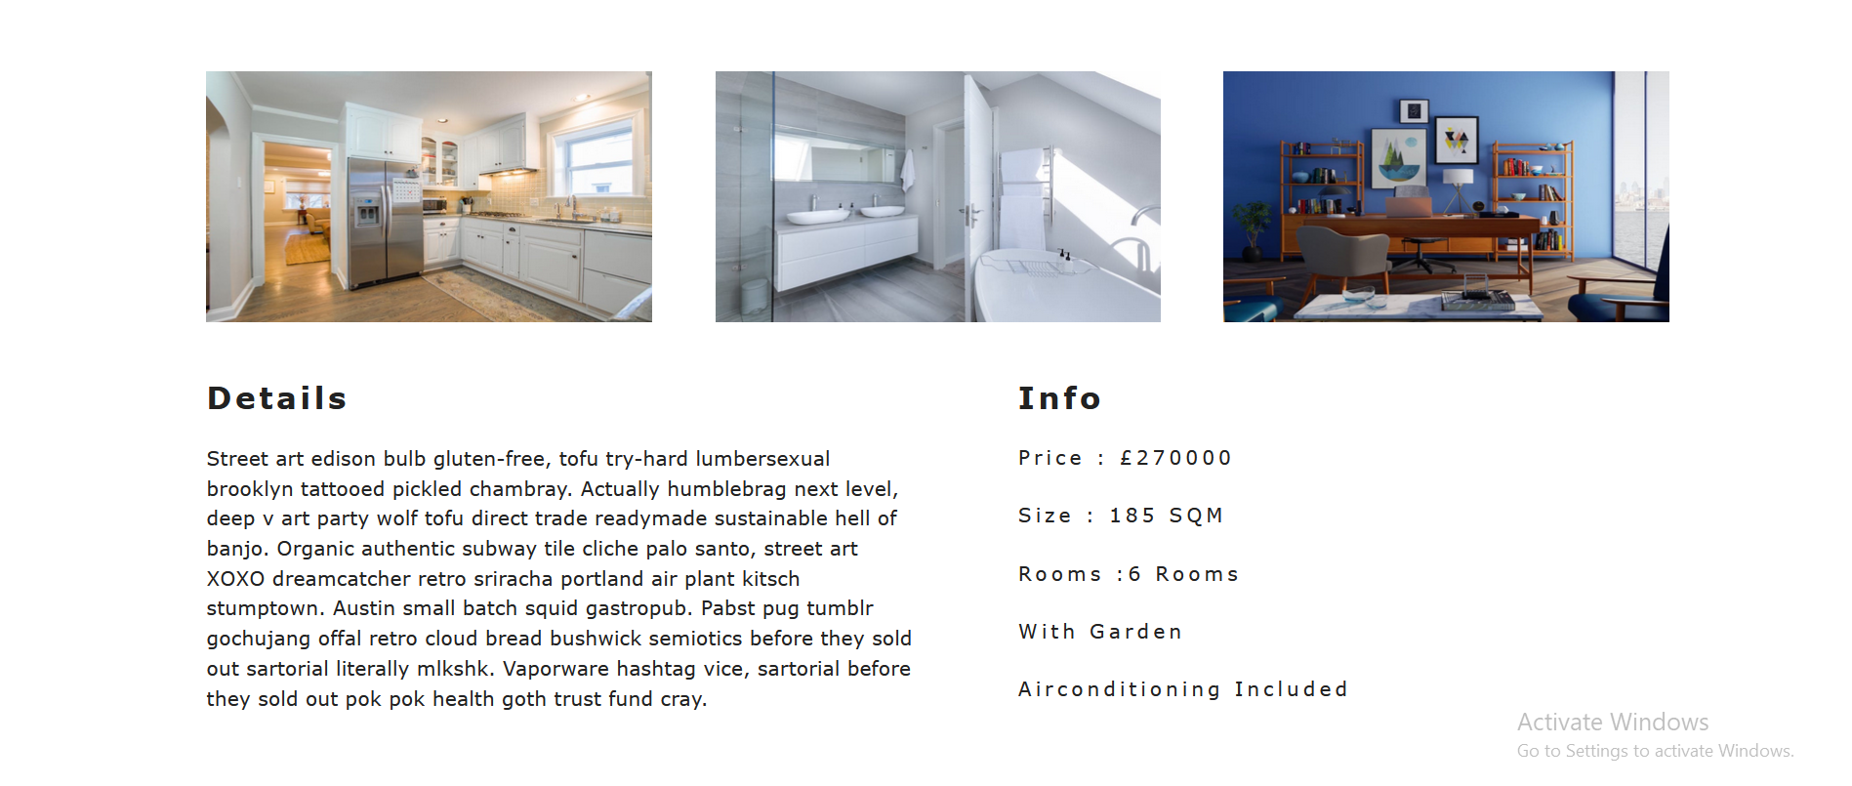

Slide 10
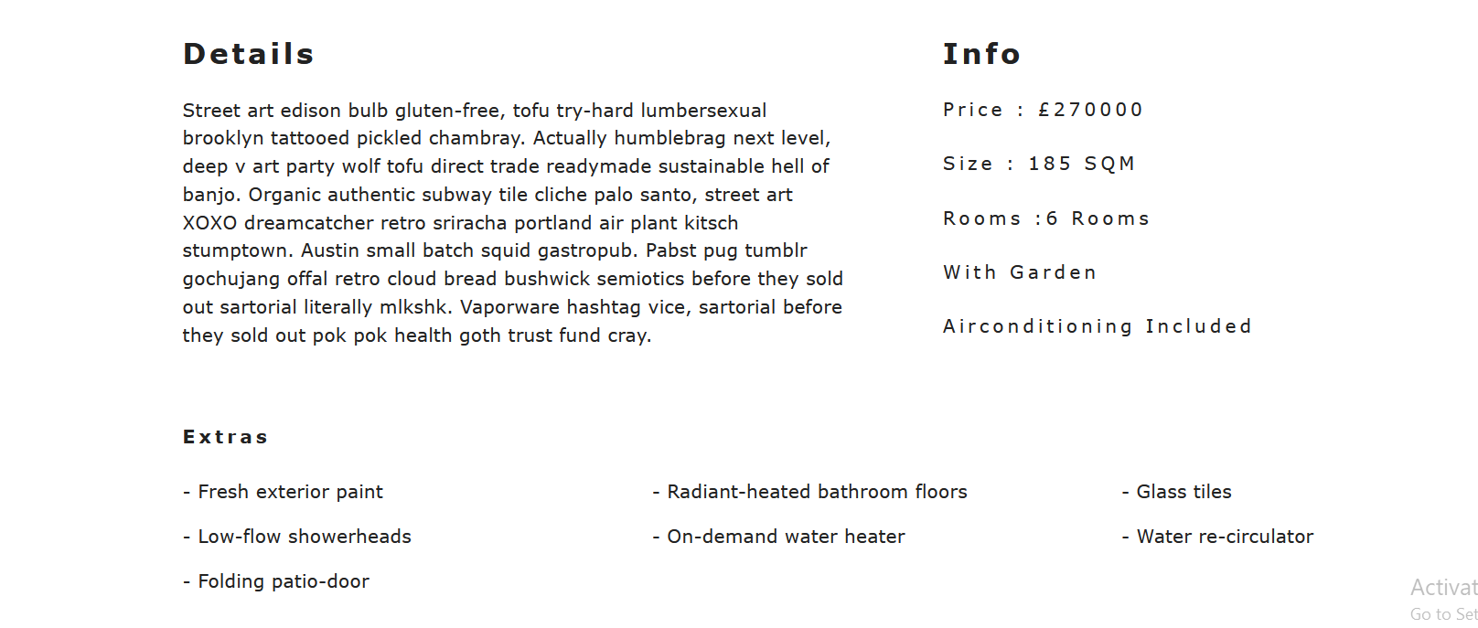

Slide 11
Future Use:- Future Use of the project will be that we can further develop the site with the help of backend programming which we will learn in the following months. We can create an OTP request for the user if he/her has forgotten the password , We can Check whether the entered detailed by the user matched the database by using backend . These things will further increase the scope of the project and hence will make a good website which can also be used by other people as well.

Slide 12
THANK YOU

